Slide 1
Linked Lists
Nikhita Anumukonda & Anita Cu

Slide 2
Implementation
class Link:
empty = ()
def __init__(self, first, rest=empty):
assert rest is Link.empty or isinstance(rest, Link)
self.first = first
self.rest = rest

Slide 3
Remember
Linked Lists have 2 Parts:
first: first element in the linked list
rest: pointer that points to the next linked list or it is empty.
Linked Lists are defined Recursively.
first
rest
8
2
3
. . .

Slide 4
When writing code, ask yourself...
What types of arguments am I taking in?
What type of values should I return? Should I construct a new Link object or mutate a linked list given to me?
Mutate by modifying .first and/or .rest
Tip: recursion can often come in handy!
Q: What would be a reasonable base case?

Slide 5
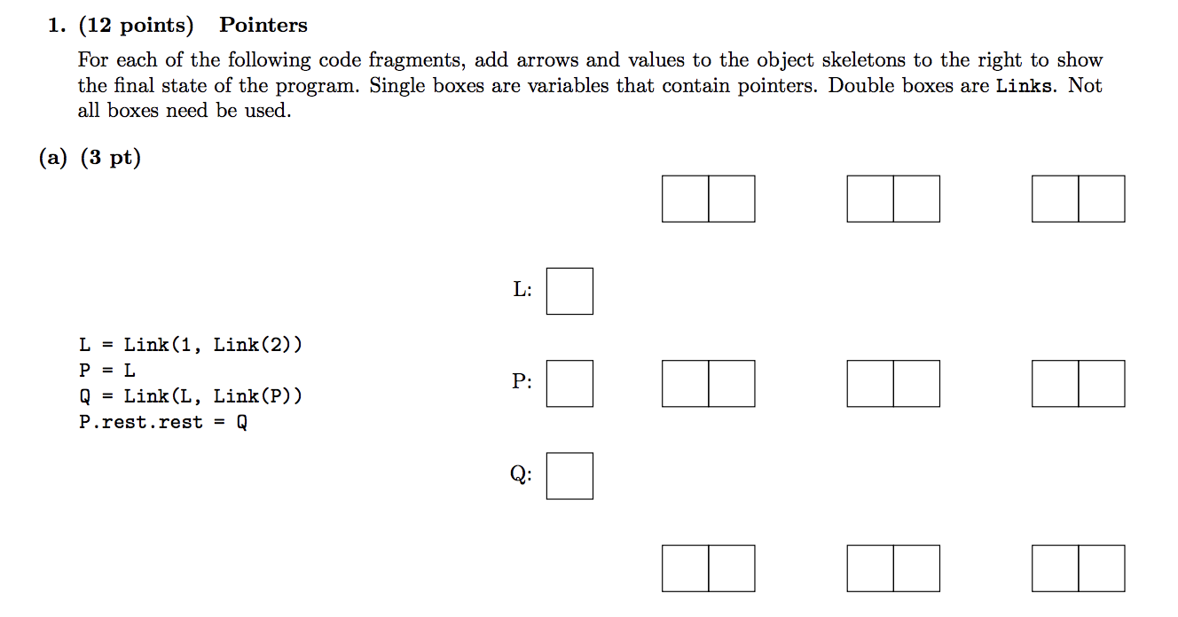
Spring 16 MT 2 #1a

Slide 6
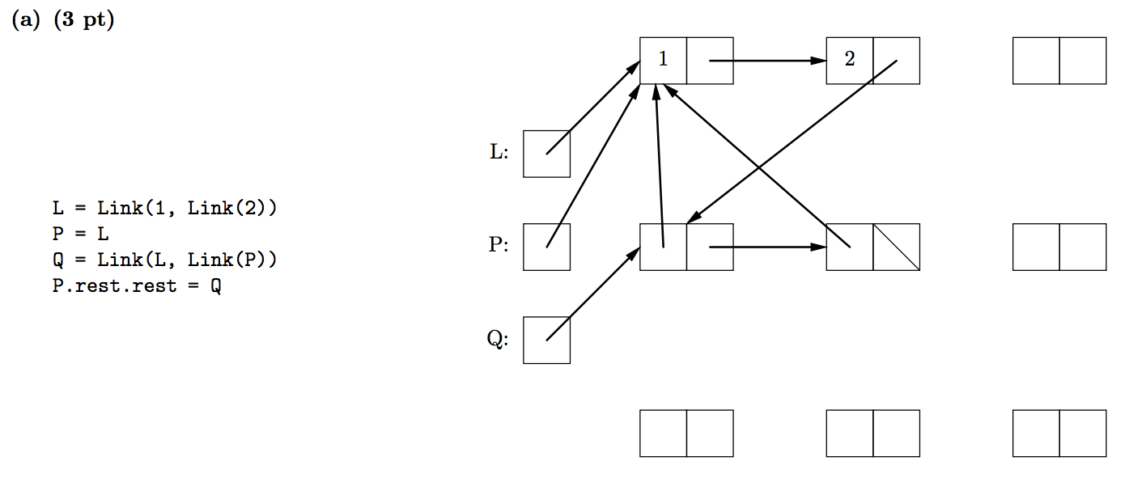
Spring 16 MT 2 #1a - Solution

Slide 7
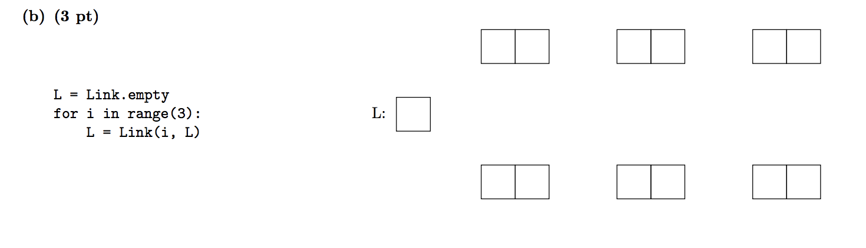
Spring 16 MT 2 #1b

Slide 8
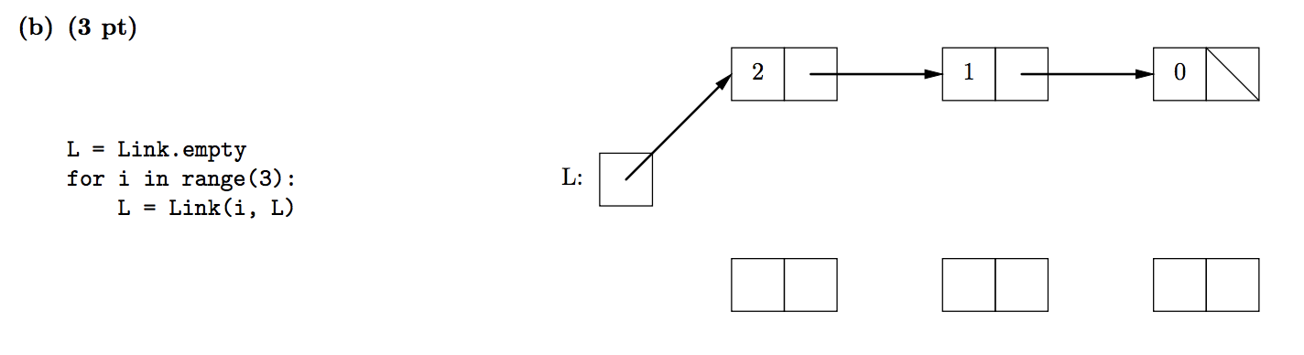
Spring 16 MT 2 #1b - Solution

Slide 9
extend_link - from Albert Wu’s website
Implement a function extend_link, which takes in two linked lists, s1 and s2. It mutates s1 such that it contains the elements of s2 and its tail. Do this mutatively and do not return anything. Also, make sure that s2 does not get attached to s1. You may assume that s1 always has at least one element.
def extend_link(s1, s2):
""" Extend s1 to include the
elements of s2.
>>> s1 = Link(1)
>>> s2 = Link(2, Link(3))
>>> extend_link(s1, s2)
>>> s1
Link(1, Link(2, Link(3)))
>>> s1.rest is not s2
True
"""
"*** Your Code ***"
http://albertwu.org/cs61a/review/mutable-linked-lists/exam.html

Slide 10
extend_link - from Albert Wu’s website
Implement a function extend_link, which takes in two linked lists, s1 and s2. It mutates s1 such that it contains the elements of s2 and its tail. Do this mutatively and do not return anything. Also, make sure that s2 does not get attached to s1. You may assume that s1 always has at least one element.
def extend_link(s1, s2):
if s2 is Link.empty:
return
elif s1.rest is Link.empty:
s1.rest = Link(s2.first)
extend_link(s1.rest, s2.rest)
else:
extend_link(s1.rest, s2)
http://albertwu.org/cs61a/review/mutable-linked-lists/exam.html

Slide 11
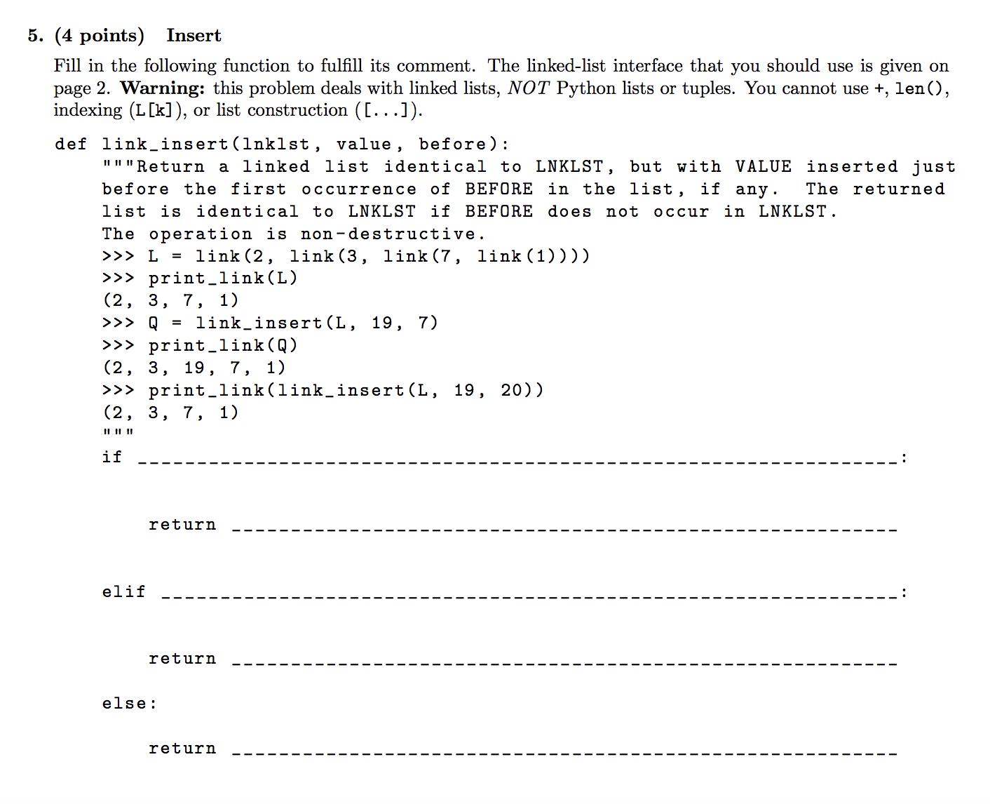
Spring 17 MT 1 #5

Slide 12
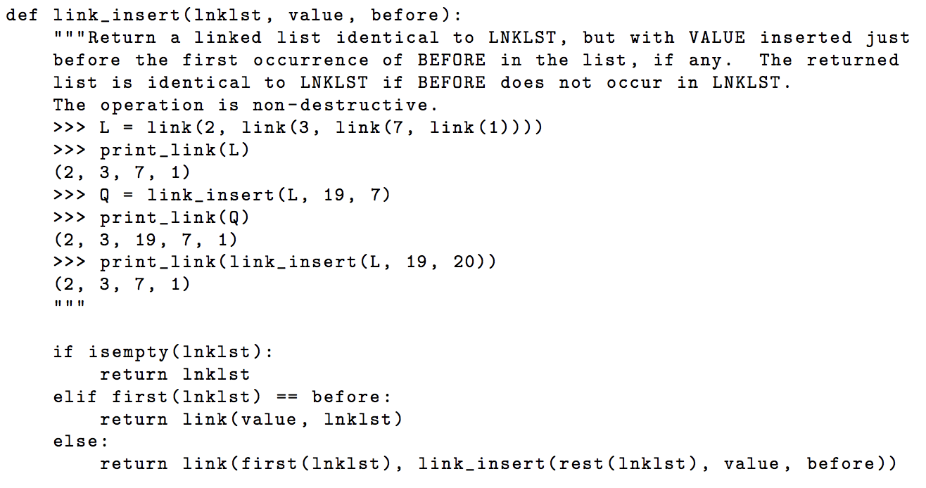
Spring 17 MT 1 #5 - Solution

Slide 13
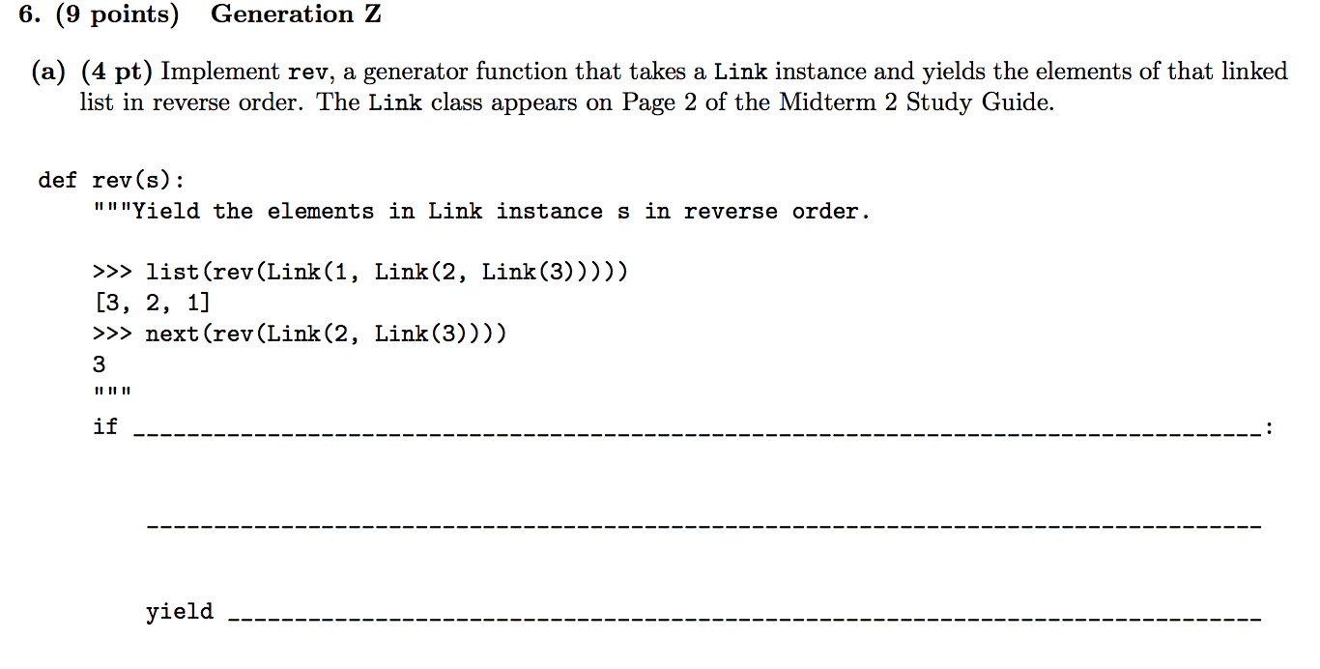
Fall 18 Final #6a

Slide 14
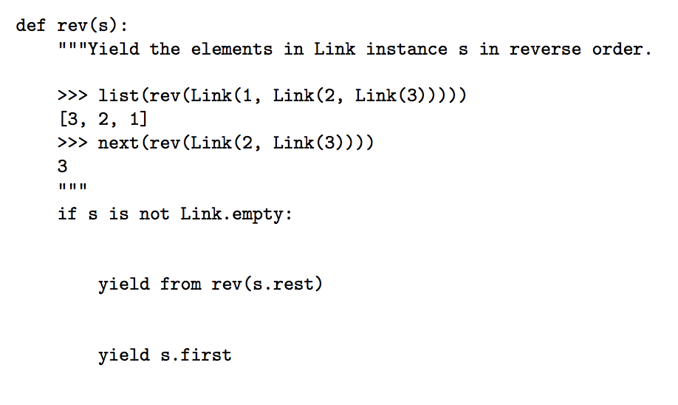
Fall 18 Final #6a - Solution

Slide 15
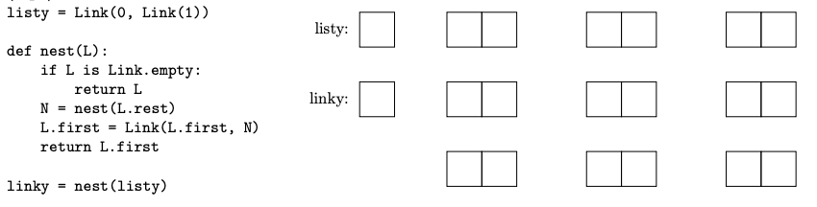
Spring 17 MT 2 #1

Slide 16
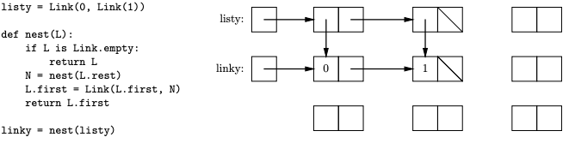
Spring 17 MT 2 #1

Slide 17
More Resources for Linked Lists
Here are some more resources for more Linked List Practice:
Albert Wu’s website: http://albertwu.org/cs61a/review/mutable-linked-lists/exam.html
Katya’s Linked List Worksheet: https://drive.google.com/file/d/0ByFhRPJ7g_tLTXBQcXhnQ3NrVU0/view
Look over: Lab 7, Discussion 7, Guerrilla Section 3, CSM Week 9
Good Luck Studying!

